Slide 1

JavaScript Vulnerabilities: How They Work, Exploits, and Impact
Understanding, identifying, and defending against JavaScript security threats in modern web applications.

Slide 2

What Are JavaScript Vulnerabilities?
JavaScript vulnerabilities are critical flaws in code or execution environments that attackers exploit to manipulate application behavior, steal sensitive data, or gain unauthorized system access.
These security gaps affect both client-side browser environments and server-side Node.js applications, creating widespread risk across the entire web ecosystem.
Common vulnerability types include Cross-Site Scripting (XSS), Prototype Pollution, Supply Chain Attacks, and Insecure Deserialization—each with unique exploitation vectors and devastating potential impacts.

Slide 3
How JavaScript Vulnerabilities Work: The Mechanics
Dynamic Nature
Exploitation Vectors
JavaScript's flexible, dynamic typing and prototype-based inheritance create numerous attack surfaces that traditional compiled languages don't expose.
Attackers target unsanitized user inputs, insecure dependencies, or sandbox escape techniques to inject malicious code into trusted execution contexts.
Prototype Pollution
Deserialization Flaws
By injecting malicious properties into Object.prototype, attackers can affect all objects in an application, fundamentally compromising the entire codebase.
Frameworks like React Server Components can enable Remote Code Execution when improperly handling serialized data from untrusted sources.

Slide 4
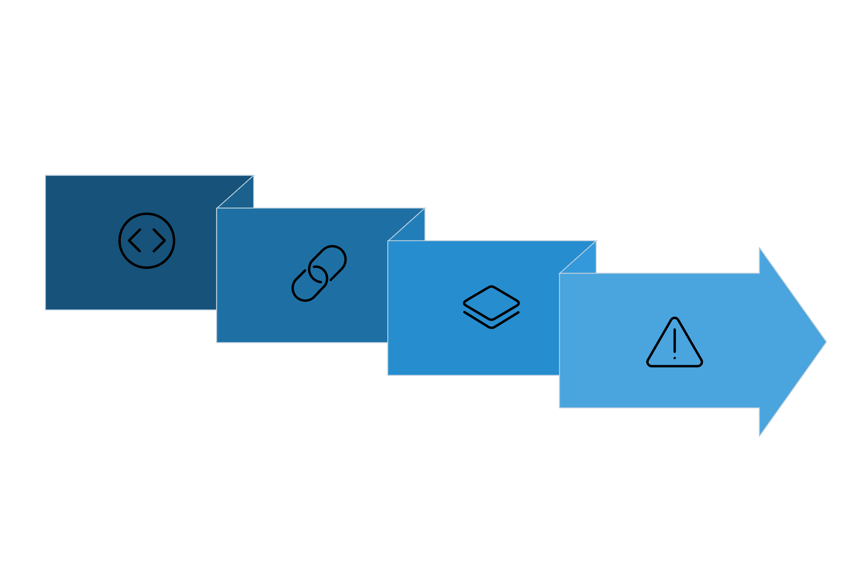




Prototype Pollution Chain
Prototype Polluted
App Compromised
Attacker Injects
All Objects Inherit
"One polluted prototype, infinite compromised objects." This visualization demonstrates the cascading nature of prototype pollution attacks, where a single injection point can compromise an entire application's object hierarchy.

Slide 5
Exploitable Vulnerabilities: Real-World Cases
2005: Samy Worm
1
Exploited DOM-based XSS to create the fastest-spreading social network worm, infecting 1 million MySpace profiles in just 20 hours through self-propagating JavaScript.
2
2018: event-stream Attack
Popular npm package hijacked via supply chain compromise to inject malicious code that specifically targeted and stole Bitcoin wallet seeds from thousands of applications.
2025: React RCE (CVE-2025-55182)
3
Critical vulnerability in React Server Components allowed unauthenticated Remote Code Execution, exploited in the wild to steal cloud credentials and deploy cryptominers on compromised servers.
4
2026: sandboxjs Breakout
Four critical CVEs broke sandbox isolation in widely-used sandboxjs library, enabling arbitrary code execution through prototype manipulation and time-of-check-time-of-use (TOCTOU) race condition flaws.

Slide 6

The Impact of JavaScript Vulnerabilities
Data Theft & Session Hijacking
Remote Code Execution
Attackers steal authentication tokens, personal information, and payment data. Notable Magecart attacks compromised British Airways and Ticketmaster, harvesting thousands of credit cards through JavaScript skimmers.
Successful exploits grant attackers complete control over servers or user environments, enabling data exfiltration, system manipulation, and persistent backdoor installation.
Supply Chain Compromise
Business Consequences
A single malicious package in the dependency tree can compromise thousands of downstream applications, creating cascading security failures across entire ecosystems.
Organizations face devastating financial losses, irreparable brand damage, severe regulatory fines under GDPR/CCPA, and long-term erosion of customer trust and loyalty.

Slide 7
Why JavaScript Is a High-Risk Target
Attack Surface Reality
44%
Vulnerable Servers
Cloud environments exposed to React/Next.js vulnerabilities in 2025
Key Risk Factors
Browser Execution: JavaScript runs with direct access to the DOM, cookies, local storage, and sensitive user data in untrusted environments.
Dependency Complexity: Node.js applications typically include 500+ dependencies, each a potential security vulnerability waiting to be discovered.
Framework Attack Surface: Popular frameworks like React, Next.js, and Vue have complex architectures that introduce sophisticated exploitation opportunities.
Ubiquitous Deployment: JavaScript powers nearly every modern web application, making it the highest-value target for malicious actors worldwide.

Slide 8






Mitigation Strategies: Defending JavaScript Applications
Input Sanitization
Dependency Management
Content Security Policy
Code Analysis & Monitoring
Rigorously sanitize and encode all user inputs to prevent XSS attacks. Never trust data from external sources—validate, escape, and encode before rendering.
Monitor CVE databases continuously and patch vulnerable packages immediately. Use automated tools like Dependabot or Snyk to track security updates.
Implement strict CSP headers to control script execution sources, preventing unauthorized code injection and reducing XSS attack surface significantly.
Deploy static analysis tools, secrets detection scanners, and dependency auditing. Monitor runtime behavior for suspicious patterns and anomalies.
Network Isolation
Secure Development
Restrict server network access using firewalls and segmentation. Implement least-privilege principles and monitor outbound connections for data exfiltration attempts.
Adopt secure coding standards, conduct regular security training, and rigorously audit all third-party code before integration into production systems.

Slide 9
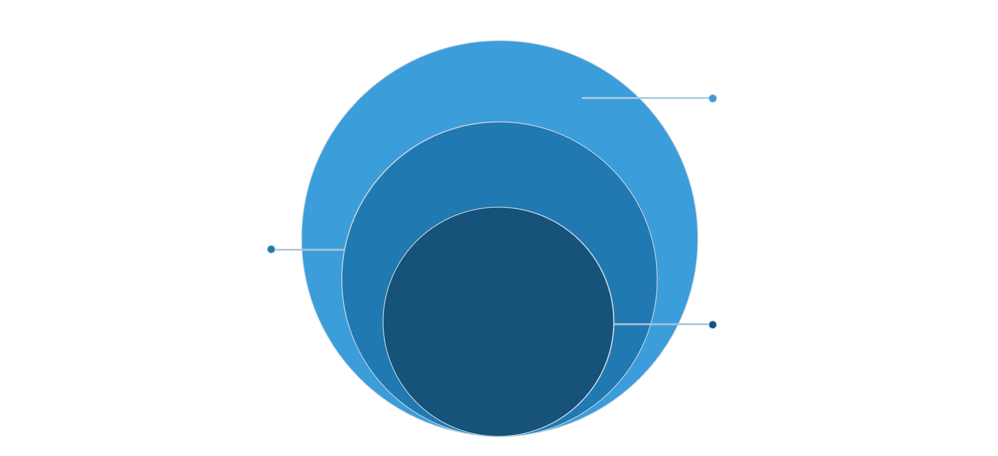
Visual: Security Layers Protecting JavaScript Apps
Top Shield
Runtime monitoring and continuous patching
Intermediate Controls
Dependency management and CSP
Core Defense
Input Validation foundation
"Defense in depth: multiple layers to secure your JavaScript ecosystem." Effective JavaScript security requires implementing overlapping protective measures at every level—from initial input validation through continuous monitoring and rapid patching cycles.

Slide 10

JavaScript Security Is Everyone's Responsibility
JavaScript vulnerabilities continue to evolve in sophistication, but they remain preventable through collective awareness, rigorous best practices, and proactive security measures.
Continuous vigilance, comprehensive team education, and investment in modern security tooling are essential pillars for safeguarding both users and critical infrastructure against emerging threats.
The cost of ignoring these risks is simply too high—from data breaches to business failure. Secure your JavaScript applications today to protect your organization's tomorrow. Security isn't just a technical requirement; it's a fundamental business imperative and ethical obligation.

